Slide 1

Software Project Management
B.E. in Information Technology Engineering
Brain Tumor Detection and Classification
Mr. Pandya Keval Rajeshbhai (190430116092)
7th Semester, I. T. Dept., SSEC, Bhavnagar,
Gujarat Technological University
Supervised By
Prof. S. J. Agravat
Asst. Prof., (I. T. Dept.), SSEC, Bhavnagar
Gujarat Technological University

Slide 2
Outline
Introduction.
Objectives , Purpose and motivation.
Project Profile.
Design Diagram.
Implementation.
Conclusion.
Reference.

Slide 3
Introduction
Brain is the most complex structure of the human body and brain tumour is one among the lethal variety of cancer. A brain tumour is a collection or mass of abnormal cells in brain. Any growth of such cells inside the brain which is enclosed by a very rigid skull can cause major pain and problems.
Brain tumours is Malignant (cancerous) or Benign (noncancerous). When benign or malignant increases, it can increase the pressure inside our skull. It can damage the brain, and may even be fatal.
This project deals with such a system, which uses computer, based procedures to detect tumor blocks and classify the type of tumor using Convolution Neural Network Algorithm for MRI images of different patients.
Different types of image processing techniques like image classification , image enhancement and feature extraction are used for the brain tumor detection in the MRI images of the cancer-affected patients.
We are using a Deep Learning architectures CNN (Convolution Neural Network) generally known as NN (Neural Network) and Transfer learning for detect the brain tumour and classify the types of tumour.

Slide 4
Objective , Purpose and Motivation
This section contains:-
Objective.
Purpose.
Motivation.

Slide 5
Objective
The main objective of the project is to detect the brain tumor properly and classify its type and give information regarding it to the doctor so the doctor can do proper treatment towards it.
Other objectives are as below:-
• To provide doctors good software to identify tumor and their causes.
• Save patient’s time.
• Provide a solution appropriately at early stages.
• Get timely consultation.

Slide 6
Purpose
The purpose behind this project is to provide better method to classify and detect brain tumor and its type in order to help doctor to provide the proper treatment regarding brain tumor.
Goal of the project:
To detect the brain tumor is percent or not.
If it is present then classify type of the tumor

Slide 7
Motivation
There has been significant increase in the numbers of medical cases involving brain tumours in last few years, ranking it 10th most common form of tumours affecting children and adults.
Detection and classification of most crucial and time taking task in field of medical image processing. Because of high variance of the size , shape , location of brain tumour Magnetic Resonance Imagining (MRI) is broadly used for detecting tumour and diagnosis various tissues abnormalities.
Accurate investigation of the size and location of brain tumour plays an important role in the diagnosis of brain tumour
The main motivation behind Brain tumor detection is to not only detect tumor but it can also classify types of tumor. So it can be useful in cases such as we have to sure the tumor is positive or negative, it can detect tumor from image and return the result tumor is positive or not.
This project deals with such a system, which uses computer, based procedures to detect tumor blocks and classify the type of tumor using Convolution Neural Network Algorithm for MRI images of different patients.

Slide 8
Project Profile
Project Name | Brain Tumor Detection and Classification
Objective | The main objective is to detect and classify the type of the brain tumor in order to help doctor in medical diagnosis
Programing language | Python 3.8-3.10
Framework | Tensor flow
Version | 1.0

Slide 9
Requirements
HARDWARE INTERFACE
SOFTWARE INTERFACE
Tools | Requirement
Processors | Inter i5 or high
Ram | 8 GB or high
Storage | 15GB or High
GPU | Up to 8 GB or more
DVR | ANY
Camera | No need
Network bandwidth | Needed(Up to 1MBPS)
Tools | Requirement
OS | Windows 7 or high , any os
Python version | 3.8 or high
C++ version | VC 2017 or high
Tensor flow version | 1.7 or high
IDE | Jupyter notebook , google colab
Framework needed | Tensorflow , numpy
Python libraries | Tensorflow , numpy , pandas , opencv , keras etc.

Slide 10
Other Non-functional Requirements
GPU:- It helps fast training the models , better data processing and fast initiation of software
ii. Good Bandwidth :- The Internet connections is required in order to upgrade the libraries.
iii. Upgraded libraries and required software: It will not cause some internal errors like module not found, etc.
iv. Better processor: - Better processer can speed up the software.

Slide 11
Design Diagrams
This section contains different diagrams like as below:-
Flow Chart.
Use Case.
Data Flow Diagram(Level 0 and Level 1).

Slide 12
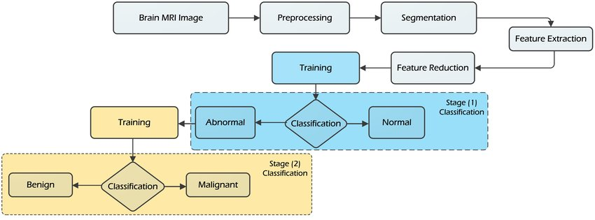
Flow Chart

Slide 13
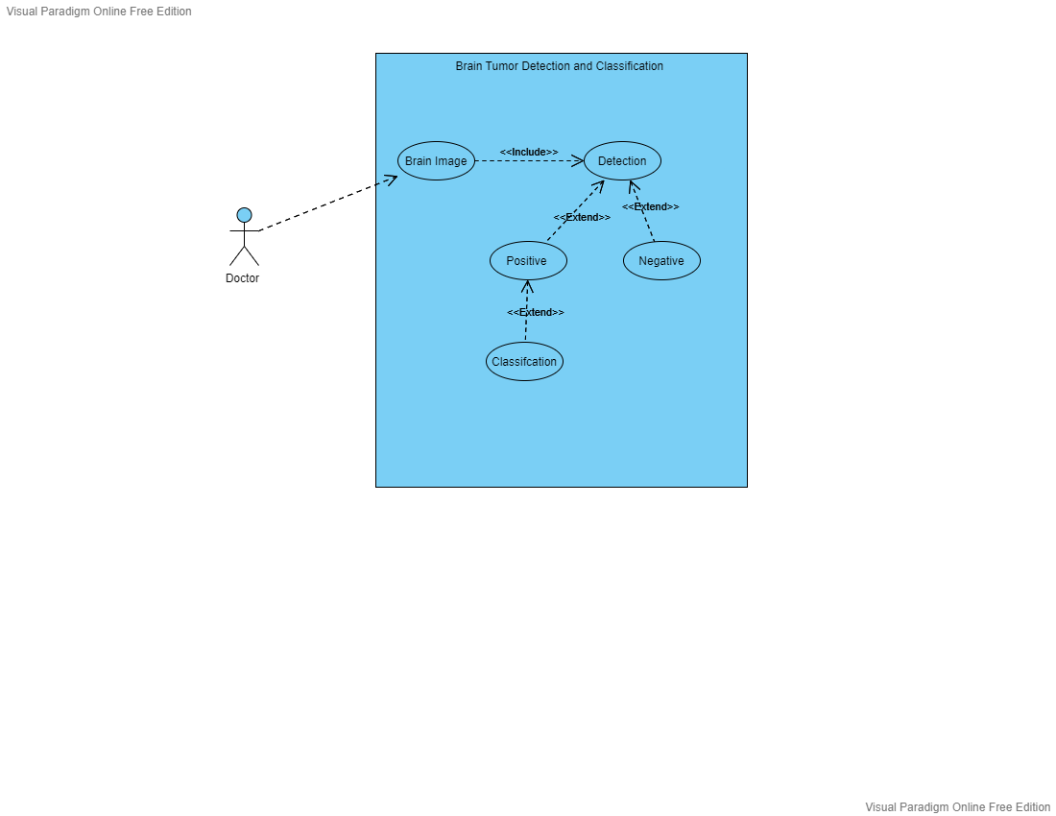
Use Case Diagram

Slide 14
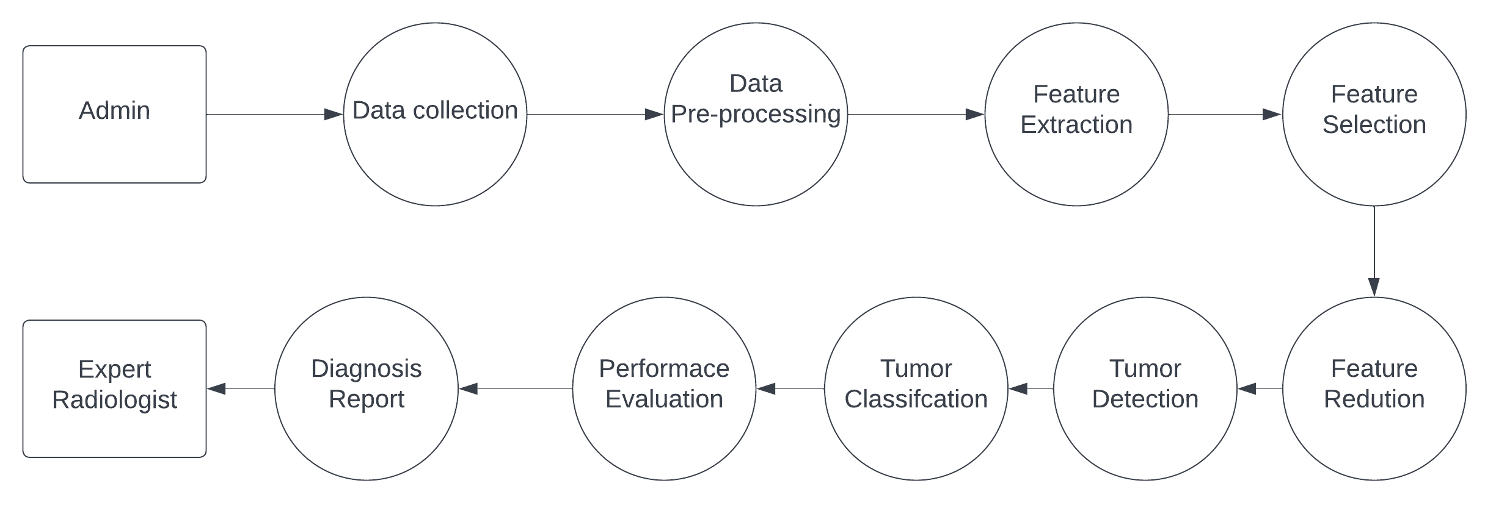
Dataflow Diagram Level 0

Slide 15
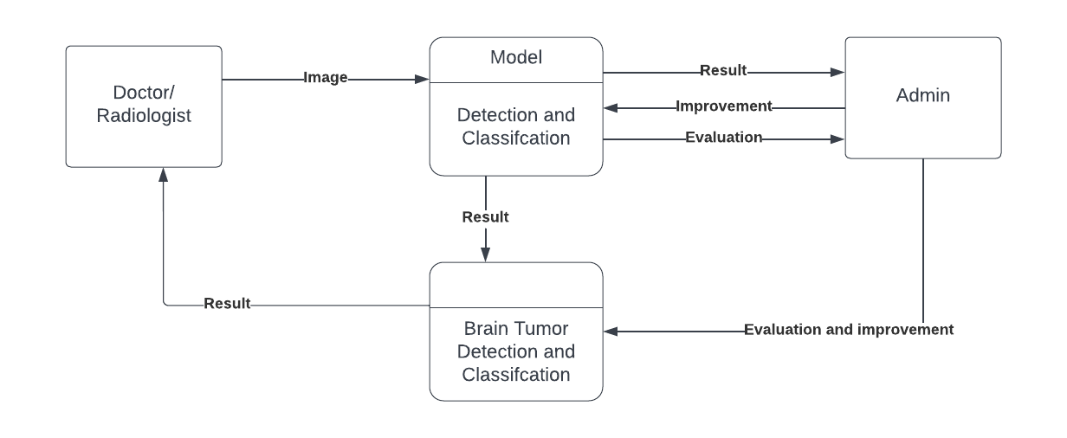
Data Flow Diagram Level 1

Slide 16
Implementation
The Major steps of the Implementation are as below:-
Build and Collect the Dataset.
Train Model.
Evaluate Model.
Model Deployment.

Slide 17
Build and Collect the Dataset.
The Data collection and building of the dataset is very import task to solve the problem of Machine Learning.
As per survey , 80% of the time is spend on data collection and pre-processing in solving the machine learning problem.
Here I am using mixture of many datasets in order to get better accuracy. Because a wise man says
“the more data , the more learning , the more learning the better results”.
The data set here I am using are from the Kaggle which is subsidiary of Google LLC, is an online community of data scientists and machine learning practitioners.
Here I am using two types of the data first one is for tumor detection and other for the tumor classification.
In the data pre-processing task I am doing following operations on the dataset.
i. Image resizing.
ii. Noise Removing.
iii. Train/Test partitioning (80/20).
iv. Removing un-necessary images.

Slide 18
Dataset Which I have Used
Here I have used two types of dataset 1.Dataset containing the image about the Positive and negative image and 2nd one which contains images of the different type of brain tumor
Detection Dataset:- The detection Dataset Here I have used is Brain Tumor dataset which is available on kaggle.com. This dataset contains 2 classes 1st is positive and 2nd is negative . This dataset contain about 4600 images . All the images are in .jpg format and 150X150 RGB images.
Classification Dataset:- In the classification dataset , I have used dataset of Brain Tumor MRI Dataset which is also from kaggle.com. This dataset contains more than 7000 images. Each images are in .jpg format and 150X150 RGB images. This dataset contains four classes .
1.glioma.
2.meningioma.
3.notumor .
4.pituitary.

Slide 19
Train the Model
After collecting and pre-processing the data , next step is training the model . It is most important step of the project.
The process of training an ML model involves providing an ML algorithm (that is, the learning algorithm) with training data to learn from. The term ML model refers to the model artifact that is created by the training process.
Here I am creating two Models 1st one for the detection of tumor and 2nd one for the classification of the tumor.
Here I am using a Deep Learning architectures CNN (Convolution Neural Network) generally known as NN (Neural Network) and Transfer learning for detect the brain tumour and classify the types of tumour.
Here I am using the tensor flow frame work for creation of the model. And also using libraries like OS, Numpy , Pandas and keras for implementation.
The programming language I used here is Python 3.8.9.
Each model is trained for 20-30 epochs using Adam optimizer and learning rate of 0.00001.
The loss function used in Detection model is binary cross entropy loss and in classification model loss function is used sparse_categorical_crossentropy loss.
The accuracy matrix is used as evaluation matrix for both model.

Slide 20
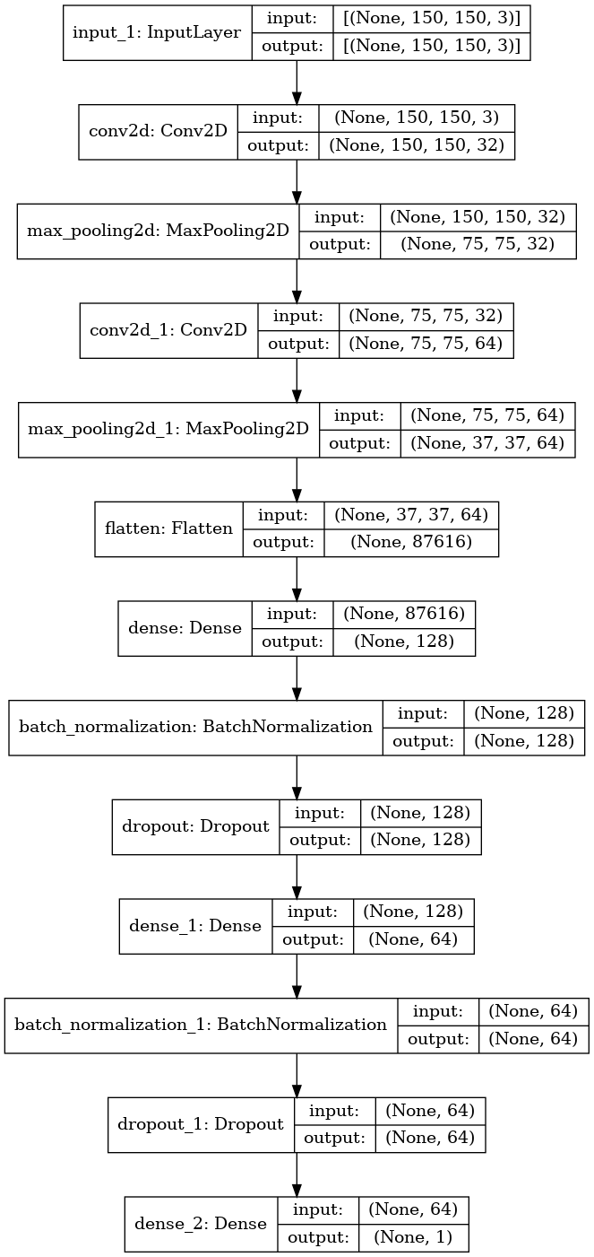
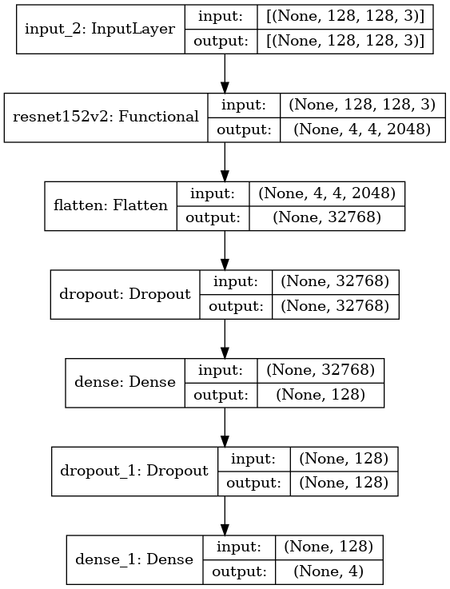
Model architecture
Detection Model
Classification model

Slide 21
Model Evaluation
The Model evaluation is based on the two losses
I . Binary cross entropy :- Binary cross entropy compares each of the predicted probabilities to actual class output which can be either 0 or 1. It then calculates the score that penalizes the probabilities based on the distance from the expected value. That means how close or far from the actual value.
II. Sparse categorical cross entropy:- It is Used as a loss function for multi-class classification model where the output label is assigned integer value (0, 1, 2, 3…).
In the backpropogation of the model , this both losses are used in order to improve accuracy and decrease the loss.
The accuracy table of model is as below.
Model | Loss used | Training loss | Testing loss | Training accuracy | Testing accuracy
Detection | Binary cross | 0.0000192 | 0.0000876 | 99.21% | 98.34%
Classification | Sparse categorical | 0.00000025 | 0.0000579 | 99.34% | 99.01%

Slide 22
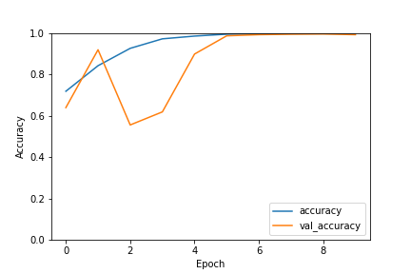
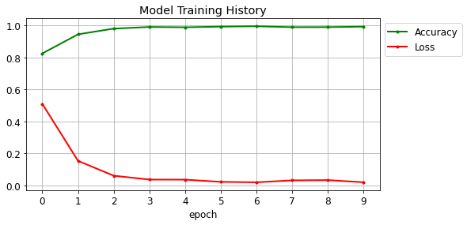
Evaluation Plotting
Detection model
Classification Model

Slide 23
Conclusion
Here I have created the computerized method for detection and identification of the brain tumor using deep learning concepts.
The input images which are slices of 3-D MRI volumes are pre-processed using an adaptive bilateral filtering technique for the elimination of noises that are present inside the original image.
The Convolution neural network is used to extract features from image in order to detect and classify the images.
Here I have also used concept of the transfer learning in order to increase accuracy.
The both propose models have accuracy almost as 99% on both training and testing set.
To avoid over fitting, we need to ensure we have plenty of testing and validation of data i.e. dataset is not generalized. This is solved by Data Augmentation and Dropout.
The main goal is to help the doctor to detect the tumor in early stage so doctor can start treatment and cancer can prevent in the early stage of development

Slide 24
References
Brain tumor detection and classification using machine learning: a comprehensive survey: - https://www.researchgate.net/publication/356000872_Brain_tumor_detection_and_classification_using_machine_learning_a_comprehensive_survey
Keras Documentation :- https://keras.io/api/losses/
Tensor flow Documentation.
Image Processing techniques using tensor flow documentation
Convolution Neural Network.
Transfer learning.
Data Augmentation.
Loss functions
Brain tumor information.
Brain Tumor Research paper
Dataset from kaggle
Python libraries documentation

Slide 25
Thank You

